Slide 1
STREAMING MUSIC ANALYSIS
Eric Meyer, Kristen Scaletta and Michelle Simek

Slide 2
Agenda
Project overview
Methodology
Analysis

Slide 3
Project Overview and Key Questions

Slide 4
Project Overview
This project explores relationships between top streamed music and song attributes, as well as rank by country and overall.
Hypothesis 1: More popular and better ranked songs tend to have higher energy, danceability, loudness and tempo.
Hypothesis 2: Artists ranked higher overall are consistently higher in multiple countries.

Slide 5
Key Questions
?
Is there a relationship between “musicalities” and rank?
Is there a relationship between “musicalities” and popularity?
How does top artists’ rank across continents compare to their global rank?

Slide 6
Methodology

Slide 7
Methodology
Data Gathering
Data Cleaning
Analysis
Collected data on top artists from
Collected data on top songs and corresponding musicalities from a May 2020 snapshot pulled from a csv generated using Spotify data (Source: Kaggle)
Process: [1] Combined data sets on artist name—needed to clean some data to get matches. [2] Grouped by artist name to get means. [3] Initially removed global rankings
Concerns: Not all artists may match
Using the cleaned data, developed charts to test each key question.
Depending on the result, adjusted chart for further exploration or better display.

Slide 8
Analysis of Key Questions

Slide 9
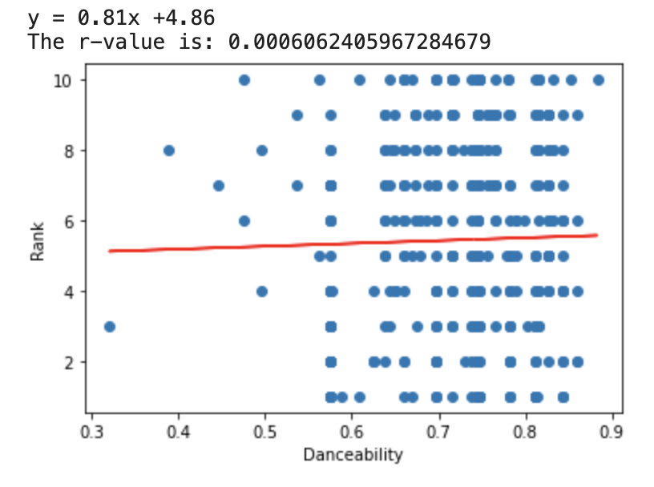
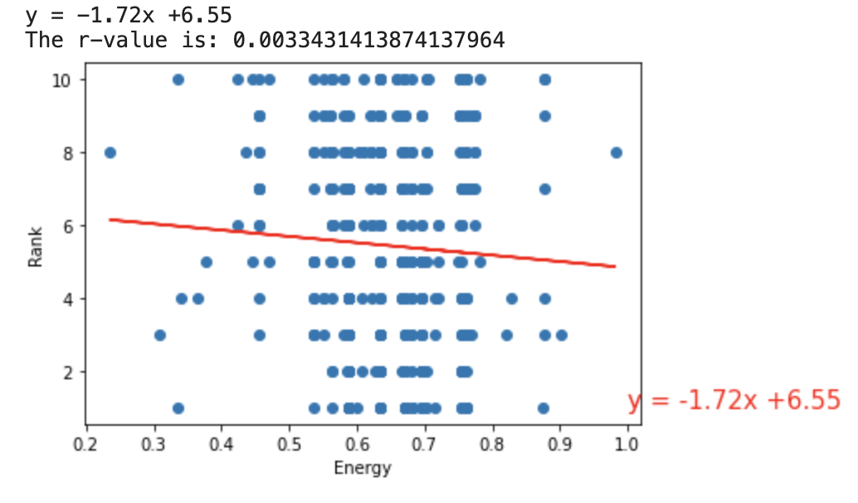
Question 1: Is there a relationship between “musicalities” and rank?
Compared song rank to various musicalities for the top 10. Musicalities includes energy, danceability, tempo, loudness, etc.
Findings: It appears there may be a very weak positive correlation between danceability and rank suggesting lower ranked songs (farther away from 1) may have more danceability.
Findings: There appears to be a weak negative correlation between energy and popularity, suggesting higher ranked songs (being closer to 1) may have more energy.

Slide 10
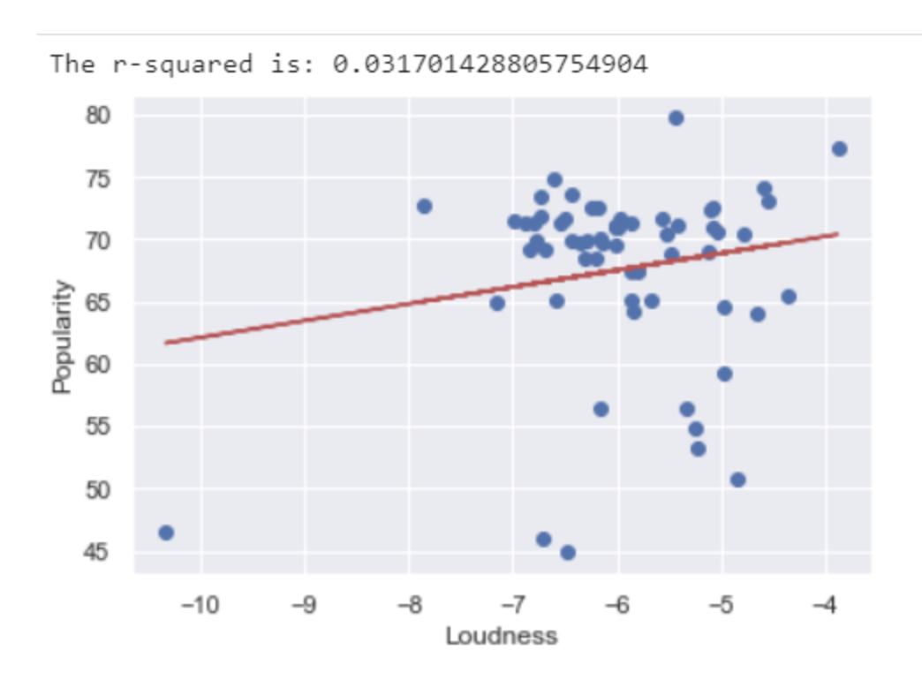
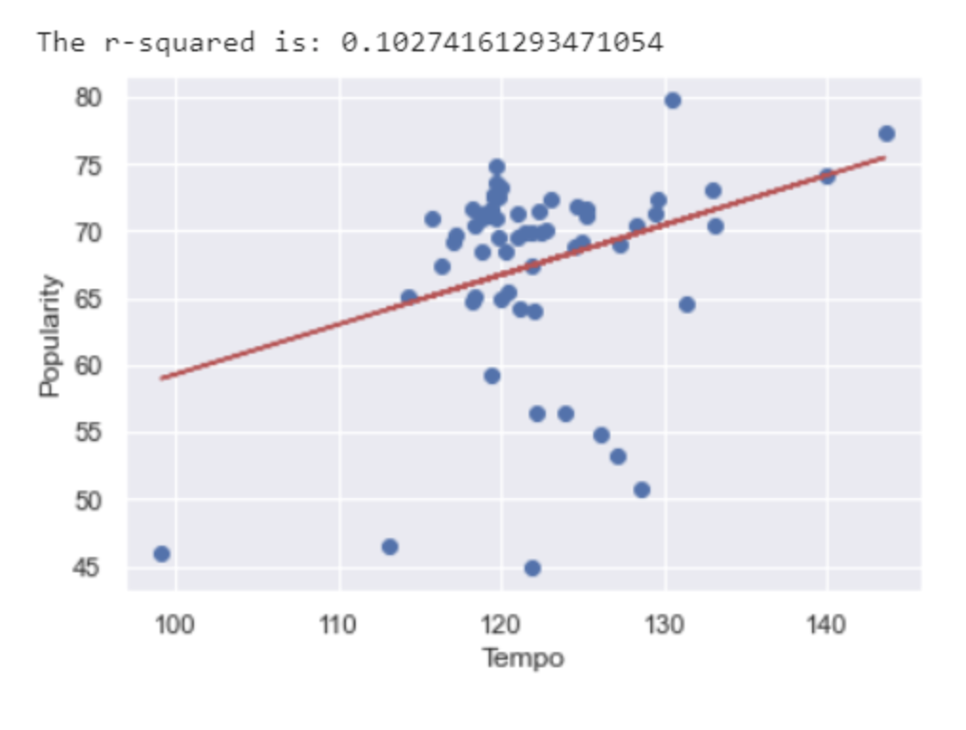
Question 2: Is there a relationship between “musicalities” and popularity?
Compared popularity to various musicalities for the top 10. Musicalities includes energy, tempo, loudness, etc.
Findings: It appears there may be a positive correlation between loudness and popularity.
Findings: There appears to be a positive correlation between tempo and popularity. Looking further into the cluster would be interesting.

Slide 11
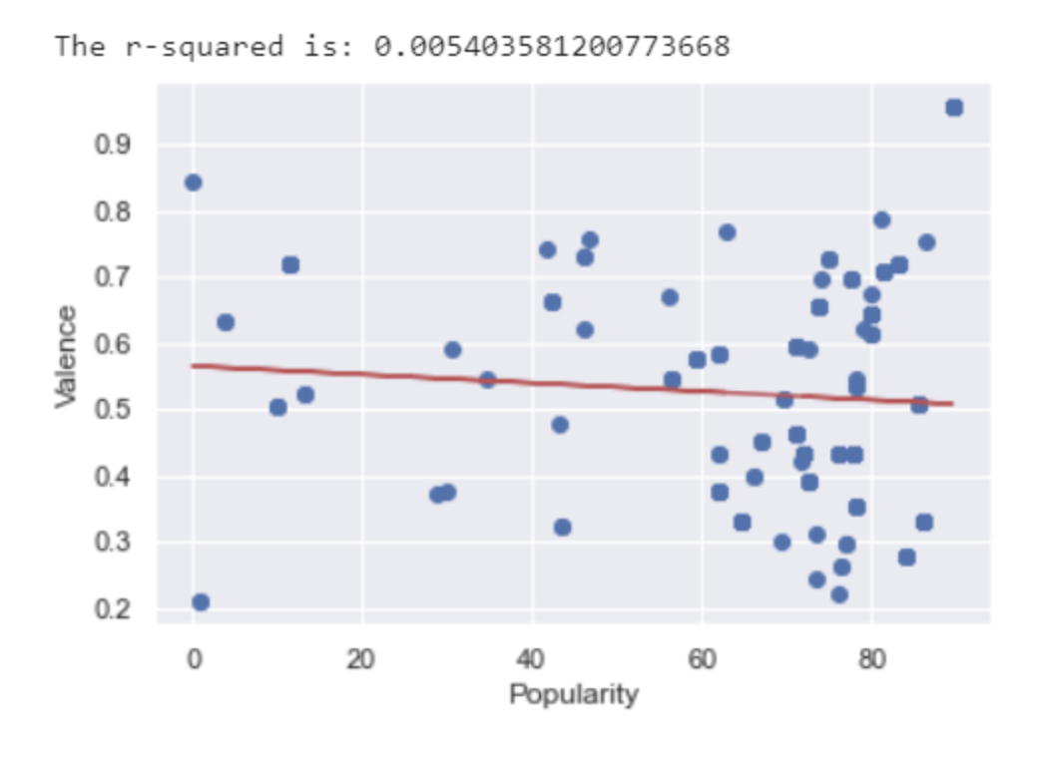
Question 2: Is there a relationship between “musicalities” and popularity?
Compared popularity to various musicalities for the top 10. Musicalities includes energy, tempo, loudness, etc.
Findings: There appears to be a weak negative correlation between valence and popularity.

Slide 12
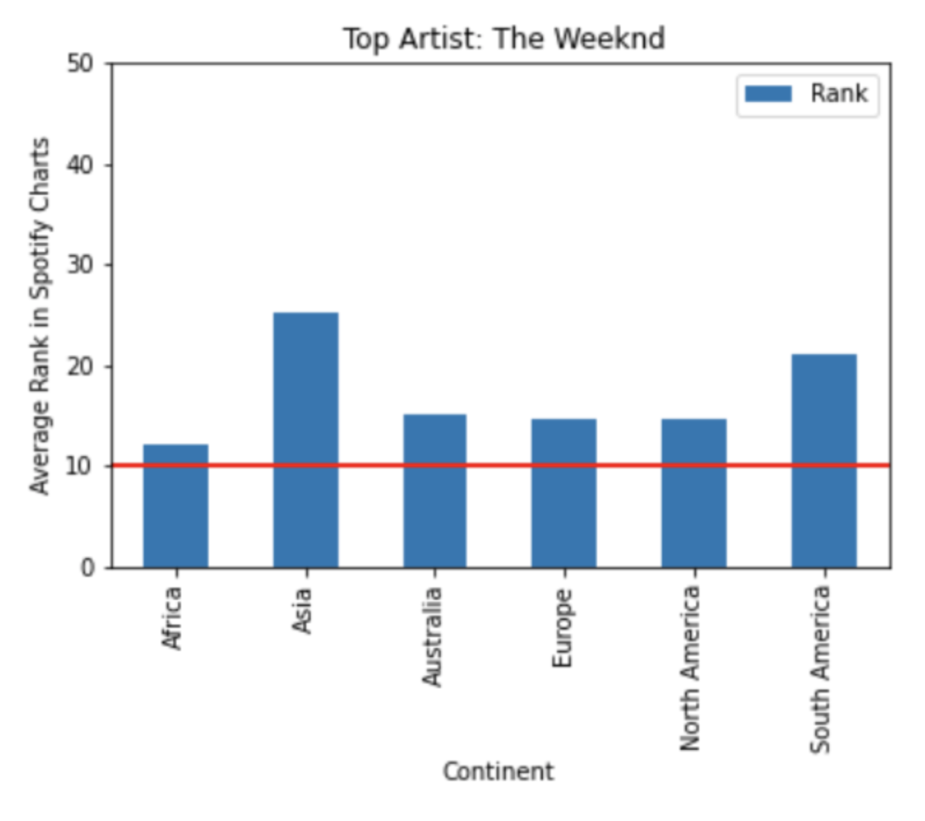
Question 3: How does top artists’ rank across continents compare to their global rank?
Looked at individual top artists’ ranks in each continent in which they are ranked compared to how they are ranked globally.
Findings: In this case, it appears the Weeknd is ranked higher globally (10) than in any continent. Would be worth looking into global ranking methodology.

Slide 13
Discussion and Next Steps

Slide 14
Discussion
Hypothesis 1: More popular and better ranked songs tend to have higher energy, danceability, loudness and tempo.
Based on this analysis, it appears there is some merit in this statement and it would be worth further exploration. Perhaps bucketing musicalities into broader song categories and seeing which together tend to result in more popular or higher ranked songs could be interesting.
Hypothesis 2: Artists ranked higher (closer to 1) overall are consistently higher in multiple countries.
This analysis shows that when artists are ranked closer to 1 globally, this is not indicative of country rankings. More research into how rankings are calculated globally and by country could be interesting to see if there is a different method.

Slide 15
Challenges and Next Steps
List difficulties:
A
B
To continue the research, in addition to what was already discussed, we could:
Look at different date ranges since the musicalitt data was from May 2020 and the artist rank data was inclusive of May 2020 but a broader time range.
Dig deeper into each country’s musicality preferences vs a global picture.

Slide 16
Questions?
?
Thank you for listening!

